Slide 1
Non-Fatal Self Injurious Behaviour – a growing problem?
Dr Adam Connor
University of Nottingham Health Service

Slide 2
Adam Connor
GP – Nottingham University Health Service
Predominately student practice 40K patients
65% of patients aged 18-25 years
Mental Health Lead for the practice
Project Lead for Self Harm at UNHS
Section 12 approved under Mental Health Act

Slide 3
My Interest in Self Harm
Aware of self harm in young people at University
More concerned the more concealed self harm I saw.
Conference lecture that showed the link between suicide and self harm
My growing daughters with relevant aged peers and ever-expanding social media network
Experience at UNHS of DSH and suicide

Slide 4
Self Harm
Most common 15 -24 yr old (10%)
F>M (6:1 12-15yr)
Only 1 in 8 in community present to hospital (> if OD)
Usually recurrent, 50% presenting to hospital have already self harmed and 18% will again and re-present within 12m

Slide 5
Self Harm
1 in 25 presenting to Emergency Department for self harm will die by suicide in the next 5 yr
40-60% of those who die by suicide have engaged in self harm
Suicide is the second most common cause of death in young people
Predictors of suicide include cutting as a modality, psychiatric treatment and male gender.

Slide 6
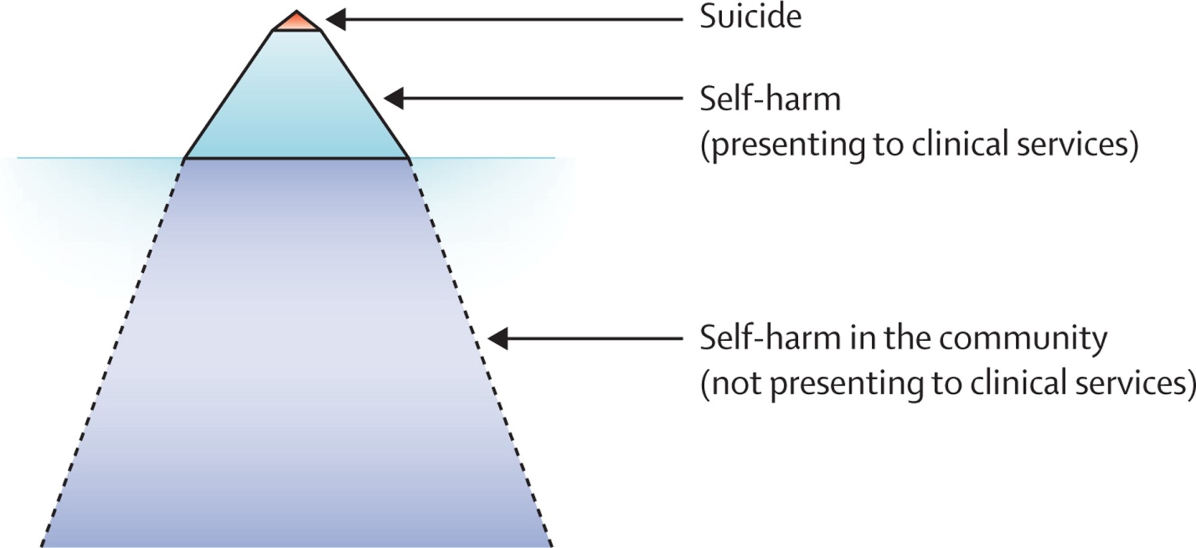
The Lancet 2012 379, 2373-2382DOI: (10.1016/S0140-6736(12)60322-5)
Copyright © 2012 Elsevier Ltd Terms and Conditions
Notes:
Representation of the relative prevalence self-harm and suicide in young people

Slide 7
What do we mean by Self-Harm?

Slide 8
What types of Self Harm are there?
1 scratching and pinching
2 hitting objects, including punching and head banging
3 cutting
4 hitting self
5 ripping skin
6 carving
7 interfere with healing
8 burning
9 rubbing/scraping skin with sharp objects
10 hair pulling
Others = overdosing, swallow things, pull nails, cut hair, sexual behaviour, drug use, alcohol XS, spending money, breaking the law, body alteration, exercise, sabotage of study or work

Slide 9
Why do people self-harm?
TRENDY?
ATTENTION SEEKING
From parents
Teachers
Friends
CRY FOR HELP?
EXPERIMENTATION
Largely Myths

Slide 10
Who self Harms
“You have so much pain inside yourself that you try and hurt yourself on the outside because you want help.” “
threw herself into a glass cabinet, slashed her wrists with a razor, and cut herself with the serrated edge of a lemon slicer. Once, during a heated argument with her husband, she picked up a penknife and cut her chest and thighs.
Her husband still scorned her, and thought she was faking her problems, that it was melodramatic attention seeking.
She threw herself down the stairs
During a fight on an aeroplane, she locked herself in the bathroom, cut her arms, and smeared the blood over the cabin walls and seats.
Princess Diana 1961-1997

Slide 11
Celebrity Self Harmers
Amy Winehouse
Russel Brand
Sid Vicious
Marilyn Manson
Courtney Love
Vincent Van Gogh
Angeline Jolie
Johnny Depp
Megan Fox
Colin Farrel
Princess Diana
Kelly Holmes

Slide 12
Why do people self-harm?
Sociodemographic and educational factors
•Sex (female for self-harm and male for suicide)—most countries*
•Low socioeconomic status*
•Lesbian, gay, bisexual, or transgender sexual orientation
•Restricted educational achievement*

Slide 13
Why do people self-harm?
Individual negative life events and family adversity
•Parental separation or divorce*
•Parental death*
•Adverse childhood experiences*
•History of physical or sexual abuse
•Parental mental disorder*
•Family history of suicidal behaviour*
•Marital or family discord
•Bullying
•Interpersonal difficulties*

Slide 14
Why do people self-harm?
Psychiatric and psychological factors
•Mental disorder*, especially depression, anxiety, attention deficit hyperactivity disorder
•Drug and alcohol misuse*
•Impulsivity
•Low self-esteem
•Poor social problem-solving
•Perfectionism- One dimension of perfectionism, an individual's belief that others hold unrealistic expectations of them, needs particular attention because it can decrease the threshold above which negative life events lead to distress.
•Hopelessness*

Slide 15
Why do people self-harm?
CONTROL
BUT
USUALLY LOSE CONTROL

Slide 16
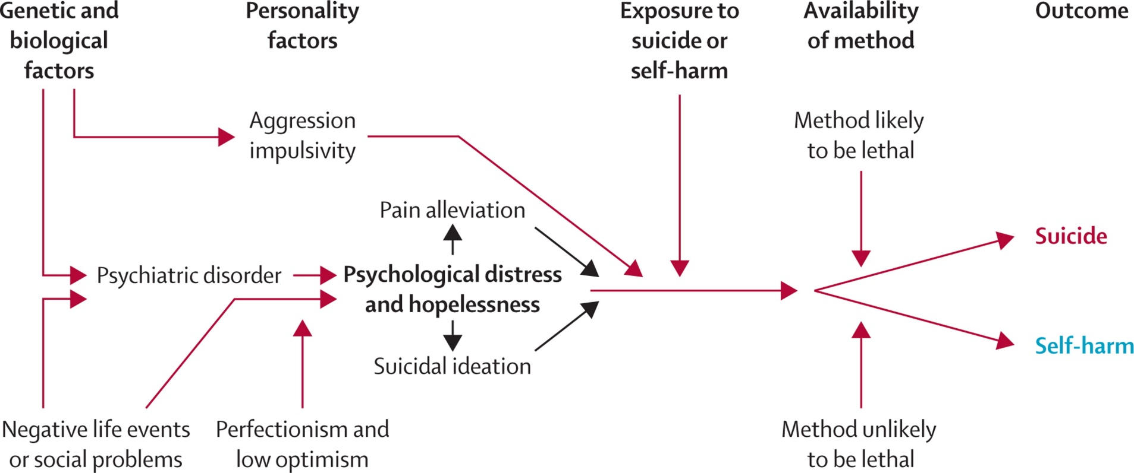
The Lancet 2012 379, 2373-2382DOI: (10.1016/S0140-6736(12)60322-5)
Copyright © 2012 Elsevier Ltd Terms and Conditions
Notes:
Key risk factors for adolescent self-harm and suicide

Slide 17
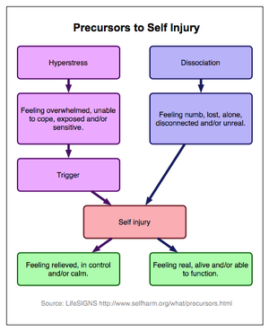

Slide 18
How to assess Self Harm
Always treat people with same care, respect and privacy as any patient – Oxford findings Saunders KE Attitudes and knowledge of clinical staff regarding people who self-harm: a systematic review. J Affect Disord 2012;139:205–16
Trust, support and engagement
Remember they are likely to be distressed by it to
Ask the patient to use their own words to explain their reasons*
Involve them in decision making and choices of treatment
Non-judgemental approach
*being listened to is deemed extremely important, especially by females - Fortune S, Adolescents’ views on preventing self-harm. A large community study. Soc Psychiatry Psychiatr Epidemiol 2008;43:96–104.

Slide 19
How to assess Self Harm
Maintain continuity of therapeutic relationships wherever possible
Ensure note keeping and communication to team is sensitive
be familiar with local and national resources, as well as organisations and websites that offer information and/or support for people who self-harm
Offer the person who self-harms relevant written and verbal information about, and give time to discuss with them, the following:
the dangers and long-term outcomes associated with self-harm
the available interventions and possible strategies available to help reduce self-harm and/or its consequences

Slide 20
How to assess Self Harm
treatment of any associated mental health conditions
Discuss with the patient about telling carers/parents and whether they need your help to facilitate dialogue
THOROUGH ASSESSMENT/PSYCHOSOCIAL ASSESSMENT IMPROVES OUTCOME

Slide 21
What Next?
Harm reductions are unlikely to work – e.g. ice cubes and elastic bands
Harm minimisation – cut this way, not that way may be seen as a form of collusion or affirmation
It is not a phase
It is not what they “need” now – it is an expression of internal distress and generally the individual wants recognition of that distress even if not ready to deal with it yet
The more time and structure therapeutic relationship there is the better longer term outcomes. ?Beyond the time constraints of most G.P.’s
Consider specialist services & refer OR local training of staff

Slide 22
Summary
Self Harm not DSH
Die by Suicide
Listen to the Story
Stop before referring
Discuss the management with the patient

Slide 23
Thanks
Dr Ellen Townsend – School of Psychology, University of Nottingham
Professor Di Bailey – School Health Sciences, Nottingham Trent University
Emma Nielsen - School of Psychology, University of Nottingham

