Slide 1
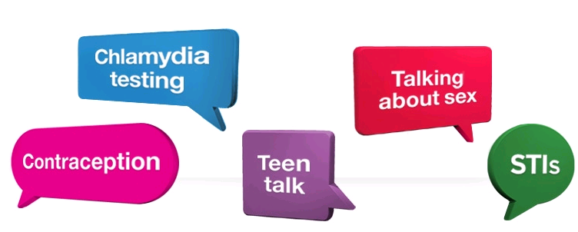
'Let's talk about....Young peoples' sexual health!'
Julia Bradley
Education Manager/Lead Nurse

Slide 2
Sexual health
Sexual health is "a state of physical, emotional, mental and social well-being in relation to sexuality...... Sexual health requires a positive and respectful approach to sexuality and sexual relationships, as well as the possibility of having pleasurable and safe sexual experiences, free of coercion, discrimination and violence."
(World Health Organisation definition)

Slide 3
The sexual health of young people Digital sexual health for young people – UCL Oct 2014
Relationships and sex are very important to young people
Young people 15 to 25 are at higher risk of sexually transmitted infection than other age groups
Many young people are at risk of getting pregnant without wanting to
Young people can experience problems like regretted sex, sexual pressure and sexual abuse
Some young people experience more health problems than others (e.g. gay men, children in care, drug-using youth, some ethnic minority groups, transgender young people)
Problems like sexually transmitted infections, unwanted pregnancy and sexual abuse cost a lot to society and we need new, effective, good-value solutions which appeal to young people

Slide 4
Sexual health information in schools and clinics
The quality of school sex and relationships education (SRE) in the UK varies enormously
A full programme of SRE education is not compulsory in UK schools
Not all schools have good access to digital technology (computers and the Internet)
It can be hard for young people to access clinics because of distance, opening times, or not feeling welcome
Asking for help with sexual health problems can be difficult
Young people would like to get sexual health information and advice from adults (parents, teachers, and clinic staff) but they also want to access it online
Young people want sexual health education which includes pleasure and relationships, not just biology, safer sex and pregnancy

Slide 5
Some facts about young people and sexual and reproductive health
Teenagers are far less likely to get pregnant today than they were in the early 1970s. The conception rate in 1970 was 82.4 per 1,000 15 to 19-year-olds, compared with 44.2 in 2012 .
There is often a wide gap between good intentions and actual behaviour. While most young people do use condoms when they first have sex, there are many reasons why others don’t. These range from not feeling able to negotiate the use of condoms or contraception, to peer pressure, alcohol, and being ‘caught up in the moment’.
After drinking alcohol, one in seven 16 to 24-year-olds have had unprotected sex, one in five have had sex that they later regretted, and one in 10 have been unable to remember if they had sex the night before because they were too drunk.

Slide 6
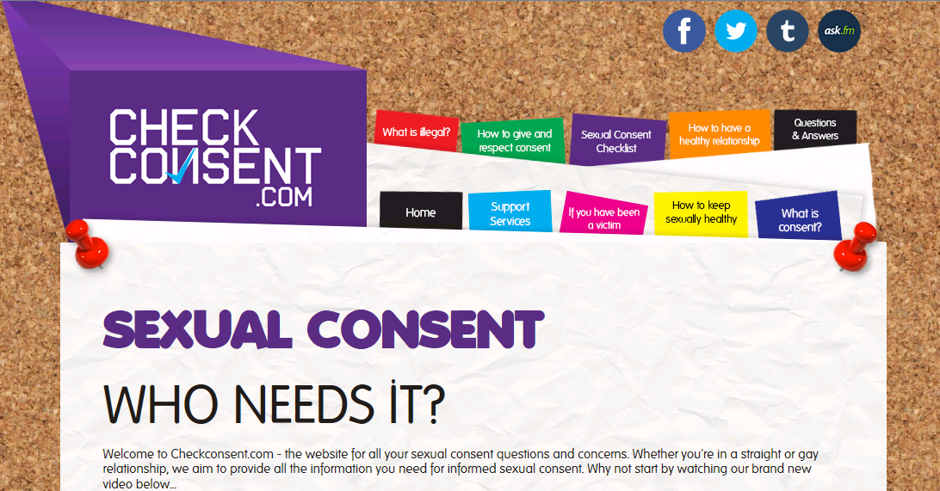
http://checkconsent.com/

Slide 7
Condoms are far more likely to break or come off if they don’t fit properly, or if they are not put on correctly. A study by the Kinsey Institute of Sex, Gender and Reproduction found that heterosexual men wearing ill-fitting condoms were more likely to report irritation, loss of erection as well as orgasm difficulties (both for them and their partners).
More than half (55 per cent) of lesbian, gay and bisexual young people experience homophobic bullying in Britain’s schools.
According to the NATSAL 2013 survey, the average age for first heterosexual intercourse is 16. Thirty one per cent of men and 29% of women now have first sex before the age of 16, which is not significantly different from the results of the previous survey (1999 to 2001).

Slide 8
But……..
Two-thirds of sexually active students have had unprotected sex, the 2014 Student Beans survey reveals.
The StudentBeans website surveyed more than 5,000 young people at UK universities about their sex lives and sexual health. They answered questions on their use of contraception, whether or not they had had a sexually transmitted infection, and their experiences of sex education.
Of those with sexual experience (89% of the respondents), two-thirds had had unprotected sex. Only 27% of sexually active students say they always use condoms, compared with 31% in 2013’s StudentBeans survey, while 35% use them sometimes and 26% just with a new partner.

Slide 9
However the poll into student sex life claims that students at Exeter University have far fewer partners than most! It has gone from being 18th in 2012 to 74th out of 109 in 2014.
The survey also found that more than two-fifths of students (45%) say they wish they'd had better sex education at school.
The survey asked where students first learned about "the facts of life"; 63% said in sex education classes at school, 34% said their parents, 36% said in the playground and 19% had looked online.
A quarter of those who responded said they would like to see more information on sexual health being offered at university.

Slide 10
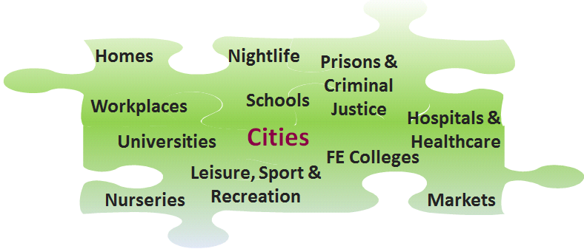
What’s the solution to this?
“In the settings approach efforts are concentrated on working to make the setting itself a healthier place for people to live, work and play…The settings approach means combining healthy policies, in a healthy environment with complementary education programmes and initiatives.” Health Promotion Strategy for Ireland (DHC, 2000)

Slide 11
University Context
More than 2.3 million students and 370,000 staff in 169 UK higher education institutions (Universities UK, 2008; HESA, 2009) – enormous potential to promote public health.
Historically, universities have served as settings for the delivery of specific projects on various priority issues, such as drugs, alcohol and mental health.
Growing focus on staff well-being, reflecting strengthened policy focus on workplace health.
Increasing interest in moving beyond single topic focus to develop more holistic and strategic ‘whole university’ approach – reflecting success of other settings initiatives (eg Healthy Schools , Healthy FE).

Slide 12
Opportunities
Nothing says you’ve arrived at university more than a free packet of condoms stuffed into your freshers’ week welcome pack. That, and the mountain of leaflets flung under your door and pinned to communal kitchen walls advertising the habitual ‘naughty schoolgirl’ and other themed club nights.
Sex, drinking and clubbing ‘til you drop is considered to be a sort of rite of passage into university life. There are no parents around to nag you for the first time, no awkward conversations between last night’s lover and your mother over the breakfast table and not a soul around to tell you what and who you can and cannot do.
With alcohol abuse and the dangers caused by excessive drinking a concern among young adults, especially university students, the Healthy University Group at the University of the West of England-Bristol (UWE Bristol) aimed to promote responsible drinking and alcohol awareness. The university developed a ‘Have a Safe Night Out’ campaign, as well as online resources and the Healthy University Group are working to raise their profile and objectives, including responsible drinking, at a variety of student events. This was all part of their Healthy Universities bid.

Slide 13
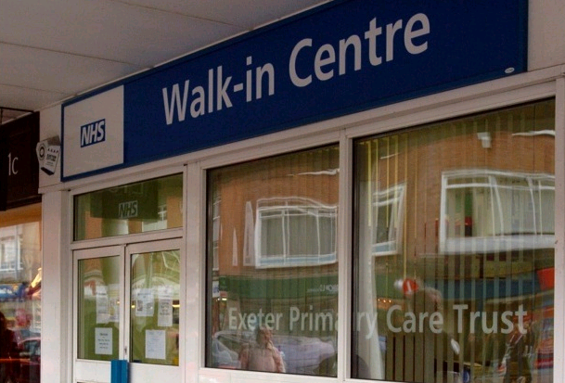
Making the links
Why promote sexual health services?
“The clinics need to be more open, they need to be more publicised… I was scared – I thought this is a place that people go to when they have sex and they do something wrong – we need to make clinics good places to go.”
There is variation in practice in YP sexual health services across the country in terms of meeting the standards set out in 'You're welcome' (DH 2007). Some services will surpass the standards, whereas others will not yet have met them.
A service completes a self-assessment toolkit that is designed to asses whether they meet the criteria and are delivering young people friendly services.
Since 2010 the Health Promotion Devon team:
Coordinated the local implementation of You’re Welcome (now called 'Young People Friendly for the South West')

Slide 14
Sexual Health Report Card 2014
Superdrug Online Doctor has ranked the sexual health services at the UK’s 50 most prestigious universities for the Superdrug 2014 Sexual Health Report Card.
Each university has been scored against nine key service areas, ranging from on-campus STI testing information, through to sexual assault services and the distance of off-site services from the main university campus.
Overall, Exeter came 33rd in the rankings, with Bristol University taking the top spot. According to the Report Card, Bristol “stood out for its forward-thinking delivery methods, setting up dedicated social media profiles to deliver a range of accessible information to help its students make informed choices about their own sexual health needs.”

Slide 15
Ranking & Methodology
The research involved extensive data capture via student welfare representatives on campus, along with follow up secondary research on those centres and 'mystery shopper' approaches. The sexual health facilities of each university were graded on 11 separate categories including:
Hours of Operation
Drop Ins or require Appointments
Location of Services
Quality of Sexual Health Information On Site
Condom & Contraceptive Availability
Quality of On-Campus Information
Special Events & Testing
Sexual Assault Resources
Student Satisfaction
Overall Website Usability & Quality
Extra Credit

Slide 16
Exeter vs Bristol

Slide 17
Responses……
The results were calculated using a combination of methods, such as mystery shopping, web research and online surveys.
Dr Vik Mohan, GP at the Student Health Centre, commented he was: “a little surprised at the scores we received through this survey.”
He added: “We will be taking this feedback seriously, and in particular will be reviewing the areas in which the feedback was suggestive of low levels of student satisfaction. This is not a survey instrument we have seen before, and will want to ensure that the areas highlighted for improvement reflect the priorities and needs of our students before making any changes.”

Slide 18
Devon Condom Card Scheme
No Judgement, No Problem….
….just good advice and free condoms
where you see this sign
Young people in Devon can get free condoms wherever you see the C-Card logo
Drop in & speak to a trained C-Card issuer for free, confidential help and information
You don’t have to be having sex to join the C-Card scheme
Sign up if you think the Devon C-Card is for you
You’ll be given a starter pack and you will be able to collect your free condoms from anyone operating the C-Card scheme
The C-Card is a totally free and confidential service for young people. If you haven’t seen the logo around and would like to know where to go in your area visit:
www.nhs.uk/worthtalkingabout

Slide 19
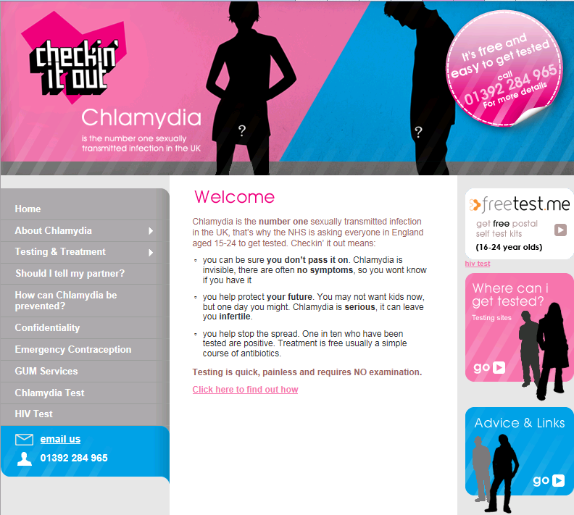

Slide 20
Impact of these initiatives?.......
PHE – Jan 2014 National Chlamydia Screening Programme web survey report
Chlamydia screening provides an opportunity to deliver safer sex messages to young adults: 90% of respondents reported that they were given sexual health information at their last test
Many respondents reported that testing had an impact on their knowledge and/or healthcare-seeking or sexual behaviour. After testing, the following proportion of respondents reported being more likely to:
o test for chlamydia again: 66%
o use condoms with new partner: 62%
o know how to avoid chlamydia 59%
o have fewer sexual partners 30%

Slide 21
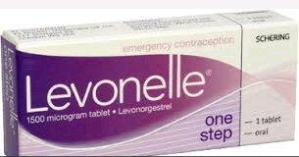
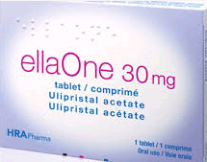
Emergency contraception
Where to get the Emergency Contraception Pill
In addition to your GP, the following options are open to you:
Contraception Service is open: Monday – Friday 9am – 6pm, Saturday 10am – 1pm, Sunday – Closed. Tel 01392 284 931
Sidwell Street Walk-In Centre is open: Monday – Friday 7.30am – 6pm, Saturday 8.30am - 6pm, Sunday 10am – 4pm. Tel 01392 276 892
Wonford RD&E Walk-In Centre is open seven days a week – 7am – 10pm. The H1 and H2 bus service runs from the High street to the hospital regularly. Tel 01392 406 300
Pharmacies
If you are aged 13-19 years, you can get the Emergency Contraceptive Pill free at Pharmacies throughout Devon.

Slide 22
Advance supply of emergency hormonal contraception?
There is strong evidence from 4 RCTs to support the advance provision of EHC to young people to increase EHC use. In most cases increased use was not at the expense of other contraceptive use, and did not promote risky sexual behaviour.
NICE, the NHS rationing body, wants to issue advice to GPs and chemists to give all women access to ‘advance provision’ of emergency contraception.
Critics say the move could fuel promiscuity and also lead to a rise in sexually-transmitted infections - because the pill is only taken after unprotected sex.
What do you think?.......

Slide 23
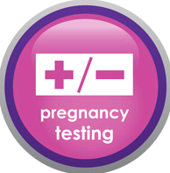
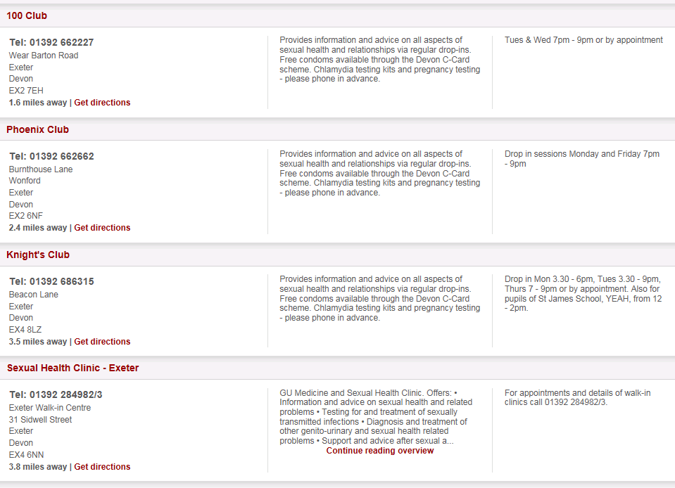
Pregnancy testing……
“Pregnant young women and their partners need to understand all the
options open to them, including abortion, so that they can make an
informed decision about whether or not to continue with their pregnancy.
The Independent Advisory Group on Teenage Pregnancy: fourth annual report 2005–6

Slide 24
Crisis Pregnancy Centres
Crisis Pregnancy Centres (CPCs) are organisations independent of the NHS that offer some form of counselling or discussion around pregnancy. Unlike government registered ‘Pregnancy Advice Bureaux’ these services are unregulated.
The quality of the service they provide varies greatly from centre to centre. Some are independently run, as charities, often with church backing, and others belong to more established networks.
Education for Choices’ 2013 report revealed a vast range of quality in terms of the service offered by different centres, but unfortunately the majority of those which were mystery shopped were found to be giving misleading information and/or biased and unprofessional counselling.
5 Heavitree Road, Exeter, Devon EX1 2LD

Slide 25
Mind the gap: is there a joined up pregnancy pathway in your area?
Do all young people know about and have easy access to free pregnancy testing and unbiased advice on pregnancy options ?
If abortion is the chosen option, do all young people have:
Swift referral to accessible NHS funded abortion service
Pre-abortion: access to accurate, unbiased information and a trained counsellor if required, chlamydia screening and support with post abortion contraception
Post abortion: access to trained counsellor if required, follow up support on contraception and sexual health

Slide 26
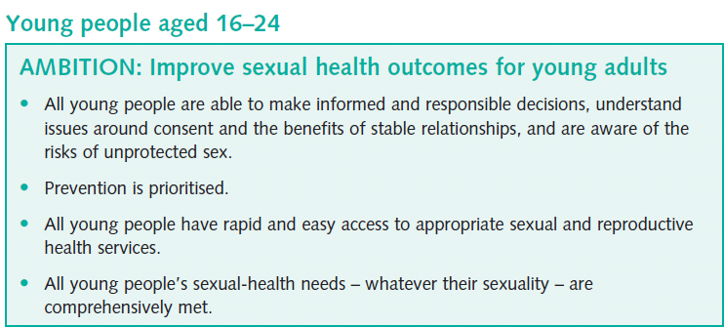
A Framework for Sexual Health Improvement in England - DoH 2013

Slide 27
Workforce training: making every
contact count
Incorporate the prevention role of the wider non-health workforce into commissioning (Sexual Health Framework)
⬥ Identifying the new assets in the system – which services and practitioners are young people in touch with?

Slide 28
Building an open and honest culture: a national and local challenge
Some overarching messages for young people and communities
Open and honest conversations about relationships and sexual health help young people make well informed choices
Asking for advice about contraception, sexual health or parenting support is the right and responsible thing to do
No wrong door – all services and practitioners will try and help

Slide 29
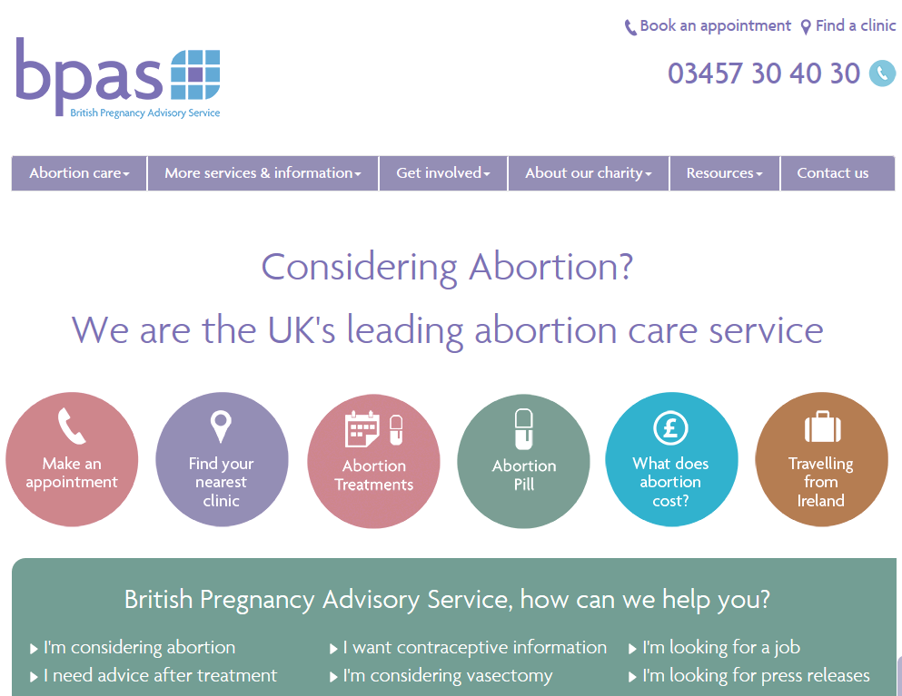

Slide 30
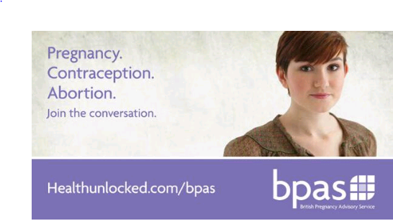
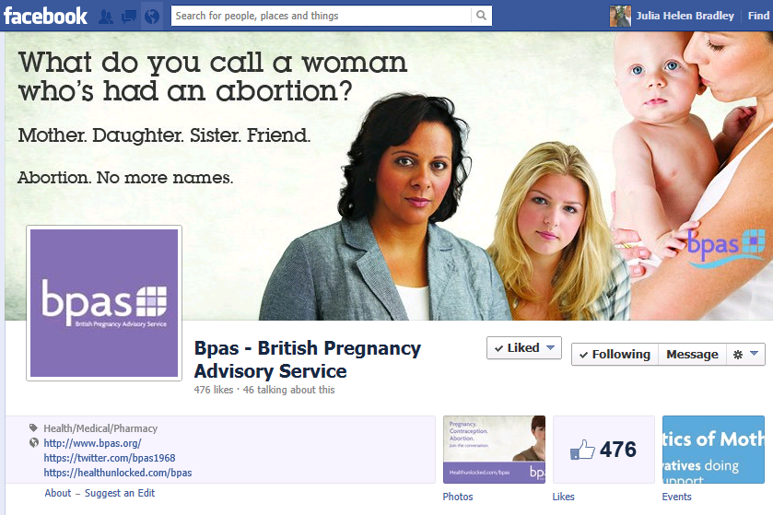
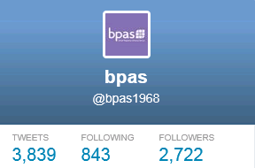
Social Media

Slide 31
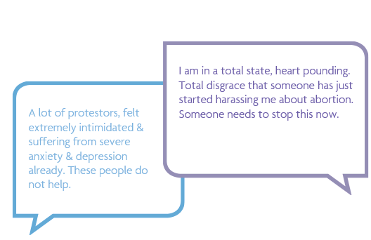
Bpas campaigns
There has been an upsurge in anti-abortion activity outside clinics in the UK.
Women attending pregnancy advice and abortion centres are now regularly exposed to groups of anti-abortion activists standing directly outside.
http://back-off.org/get-involved/

Slide 32
References
1. Conceptions in England and Wales 2012. Office for National Statistics (ONS), 2014: England and Wales only. Comparable data over the same period of time is not available for Scotland or Northern Ireland.
2. Brook, Sexual Health Resource Pack for professionals working with young people in Milton Keynes.
3. Alcohol Concern www.alcoholconcern.org.uk [accessed 05.06.14]
4. Kinsey Institute for sex, gender and reproduction, and published in the journal Sexually Transmitted Infections (August 2009)
5. Guasp, A (2012) Stonewall The School Report p4, Centre for Family Research, University of Cambridge.
6. Sexual attitudes and lifestyles in Britain: Highlights from Natsal-3, The National Survey of Sexual Attitudes and Lifestyles. http://www.natsal.ac.uk/media/823260/natsal_findings_final.pdf?utm_source=2013%20 Findings&utm_medium=Download&utm_campaign=Infographic%20findings%202013 [accessed 05.06.2014]

Slide 33
Any questions????
Thanks for listening!

