Slide 1
using the patient voice: making the most of your patient participation group
Working with a student population
Chloe Rankin

Slide 2
Welcome and introductions
Chloe Rankin;
Leeds Student Medical Practice,
Healthwatch Leeds
Audience;
Practice Managers, Admin, Clinicians,

Slide 3
Today’s Session
Introducing Patient Participation Groups;
Benefits and Barriers
Working with students
Virtual PPG, Case study from LSMP
Using patient feedback to direct services
Suggestions for your own practice
Questions

Slide 4
…“Where Patient Participation Groups and GP practices are working well together, these partnerships have already brought significant value to patients and practice staff”…
Professor Nigel Mathers, Honorary Secretary of the Royal College of General Practitioners

Slide 5
Patient Participation Groups (PPG’s)
Group of patient volunteers
Aims include (but not limited to);
Improve communication channels
Contribute to service improvement
Support the practice
Help patients take responsibility for their health
April 2016: All GP practice in England have to have one

Slide 6
What are the benefits of having a patient participation group?

Slide 7
Benefits of a PPG
Critical friend
Give the patient perspective
Suggest service improvements
Provide a link to improve communication
Organise health promotion events
Run volunteer services
Carry out research of patient views
Influence commissioning
Fundraise to support the practice

Slide 8
What are the barriers for staff running a patient participation group?
What are the barriers for patients engaging with a patient participation group?

Slide 9
Barriers to a successful ppg
Patient perspective:
Don’t know about it
Timing of meetings
Location of meetings
Don’t have time
Don’t think they will make a difference
Lack of support
Practice perspective
Don’t know where to start!
Staff capacity and training
Struggling to recruit members
Poor engagement
Funding

Slide 10
Patient Participation Groups (PPG’s)
No set rules/guidelines for how PPG’s are run
Need to be bespoke to the practice
Not ‘one size fits all’
Barriers = opportunities

Slide 11
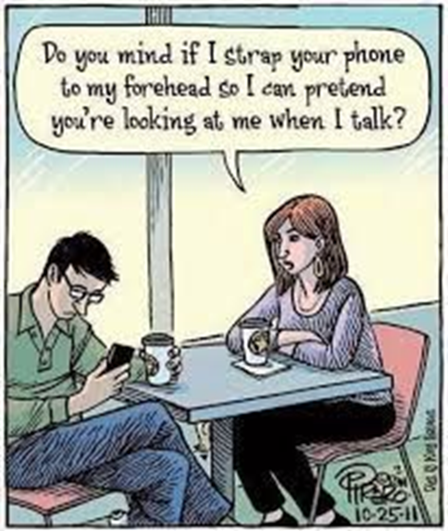
Perceptions of students/young people
Pictures: teensdontdrivedistracted.wordpress.com, www.pinterest.com

Slide 12
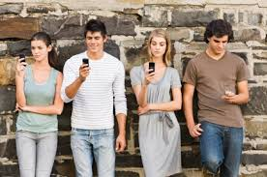
Working in a student practice
Pictures; www.teensafe.com, yourteenmag.com, blog.homefinder.com, www.huffingtonpost.com, www.dailymail.co.uk

Slide 13
Using A Virtual PPG
A Patient Participation Group run online via a ‘private’ Facebook Group
Or email, online forum, website?
Picture: www.dailymail.co.uk

Slide 14
PPG at Leeds Student Medical Practice
We have 61 members in our Facebook group
Recruitment; posters, waiting room, word of mouth
Focus on PPG as our ‘critical friend’
Feedback via private message (incentives)
Patient surveys
Face to face meetings; Once per term, Staff attendance, Agenda designed around patient feedback
*Always looking to develop*
Notes:
I am now going to talk you through a case study example from my own practice. Leeds Student Medical Practice is a GP practice in Leeds with around 38,000 patients registered.
It is an interesting practice in that it is predominantly for the student population in Leeds with patients from The University of Leeds, Leeds Beckett University, Leeds Trinity University, Leeds College of Music, Leeds College of Art… so patients often stay for one year, three years a bit longer if they are completing postgraduate studies. In addition, patients often go home during university holidays such as Christmas, Easter and Summer. Some overseas students go back abroad making contact very difficult.
With this crazy dynamic from such a transient population it is impossible to develop a consistent group of patients who would attend meetings as the LSMP Patient Participation Group. Instead we use the Facebook group as this can be used for feedback at all times of the day, week and year. We have 61 members in this Facebook group recruited via posters around the practice, approaching patients in the waiting room and word of mouth from patients and staff.
Generally speaking, our PPG is a critical friend for us – advising us on the patient perspective and helping to improve the practice by giving suggesting and feedback on current services.
All patients who join the PPG on Facebook are given the opportunity to provide feedback via private message. All feedback that is received is responded to and sent around the practice.
We often undertake patient surveys in the waiting room to gather information and we also have face to face meetings once per academic term at the practice. The Practice Manager, a GP Partner, Lead Nurse and Project Coordinator all attend this and the agenda is designed around patient feedback we have received from the Facebook group and patient surveys.
Examples of agenda items include:
what do you think of the appointment system,
What do you think of your welcome to the practice
What do you think the nurses should wear
how do you think we should promote campaigns,
do you like the waiting rooms etc
We are always looking to develop, so we plan to do a recruitment drive in September.

Slide 15
“I've always had a very positive experience of LSMP- the same day appointments work brilliantly and are very accommodating for university contact hours so they're hugely convenient”

Slide 16
“The receptionists have always been extremely helpful and every single doctor or nurse I have ever seen there has been extremely nice and amazingly professional and helpful. After many bad experiences I have had elsewhere, I cant sing their praises enough”

Slide 17
“Dr Milligan's honestly changed my life regarding my anxiety and eating disorder and you can tell he really cares”

Slide 18
Using patient feedback to direct services
You said… we did…
Increase use of social media
Customer service
Booking appointments for students on placement
Newspapers
Waiting room decorations
Text messages update to reduce DNA’s
Newsletter

Slide 19
Keeping the PPG updated
You said…we couldn’t because..
Seating
Radio
Barriers in waiting room

Slide 20
What would you suggest for your practice?

Slide 21
Tips for success
Recruit, recruit, recruit!
Use appropriate engagement for the population
Use numerous methods of engagements
The PPG should be guided by them!
Always respond to feedback
Keep your PPG updated
Thanking your PPG

Slide 22
Thank you for listening
Don’t forget to join your PPG! ☺
Chloe Rankin
chloe.rankin@nhs.net
0113 295 4488
http://www.leedsstudentmedicalpractice.co.uk/
http://www.healthwatchleeds.co.uk/

