Slide 1
Primary Care Support England
General Practice
June 2016

Slide 2
Today
What we are looking to achieve
Transforming primary care support services
The timescales
What does this mean for General Practice?
Contacting PCSE:
  Customer Support Centre
  PCSE website
  National Engagement Team (NET)
Get involved

Slide 3




What we are looking to achieve
Consistent, national services
Safe and reliable service delivery
Cost savings
Ultimately - improved customer service
Cost savings

Slide 4















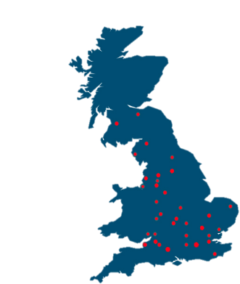













Transforming primary care support services
GPs
Practice staff
Dentists
Pharmacists
Opticians
Broader stakeholders
User Portal and Customer Support Centre
Face to face
Phone
Letters
Email
Portal
Text
Fax
Business Support Functions (Leeds)
3 x multi Disciplinary Service Centres
Specialist Services Centres
Local Delivery Capability
Compliance
Risk management
Quality framework
Change governance
Metrics and reporting
Process management
People management
Behavioural Science
Clinical Governance
Supplier Chain Management
Workflow
Controls
Support Centre (Leeds)
Market Entry (Leeds)
Performer List (Leeds)
DMS (Preston)
Scanning (Darlington)
Storage (Darlington)
Printing (Mansfield)
Leeds
Preston
Clacton
Market Entry
Screening
Payments & pensions
Registrations
Performer Lists
Probity (Preston)
Training and Support
Outsourced Logistics

Slide 5
The timescales
 | Services | Q3 - 15 | Q4 - 15 | Q1 - 16 | Q2 – 16 | Q3 - 16 | Q4 - 16 | Q1 - 17 | Q2 - 17 | Q3 - 17
Service Transformation | Customer Support Centre opens
 | Medical Records Movement
 | Supplies management
 | Ophthalmic Payments
 | Pharmacy Payments
 | Performer List
 | Market Entry
 | GP Payments & Pensions
 | Screening Administrative Support
 | Contact moving from local office to Customer Support Centre

Slide 6





What does this mean for General Practice?
Supplies
March 2016
Medical Records
March 2016
Payments
June 2017
Screening
April 2017
Performer
Lists
May 2017

Slide 7

Medical records
Introducing a standardised safe and reliable new process
Using one national courier firm, CitySprint, to provide a secure, weekly records collection and delivery service
Collecting from practices and delivering directly to their end destination
Providing all practices with new shipping bags in three different sizes
Printing tracking labels centrally and delivering on the weekly courier visit
Introduced an online portal where you can track the movement of each record

Slide 8
Medical records
Feedback from the West Yorkshire pilot
Branch surgeries – confirm the process
Transit labels – print in alphabetical order
Provide additional pick-ups if records to be collected reaches a certain threshold
Consider providing reusable shipping bags
Look at options for practices who store records in A4 envelopes
Look at options for updating patient info on the front of MREs

Slide 9
Medical records
What else does my practice need to know about the new process?
Urgent Medical Information Requests: email the CSC
New registrations: MREs delivered via CitySprint
Maintaining patient records: responsibility of each practice
GMS3 forms: scan and upload to the portal, or request a label and send in shipping bag
Tracking records – manage through the portal
CitySprint: all couriers DBS checked, should wear uniform and carry ID

Slide 10

Supplies management
Introducing a standardised approach for ordering supplies
The PCSE Portal houses the national catalogue of approved items – including stationery, prescriptions pads, needles and syringes
All orders can be placed online
All orders placed can be viewed and tracked online
CitySprint provide a secure weekly supplies delivery service

Slide 11
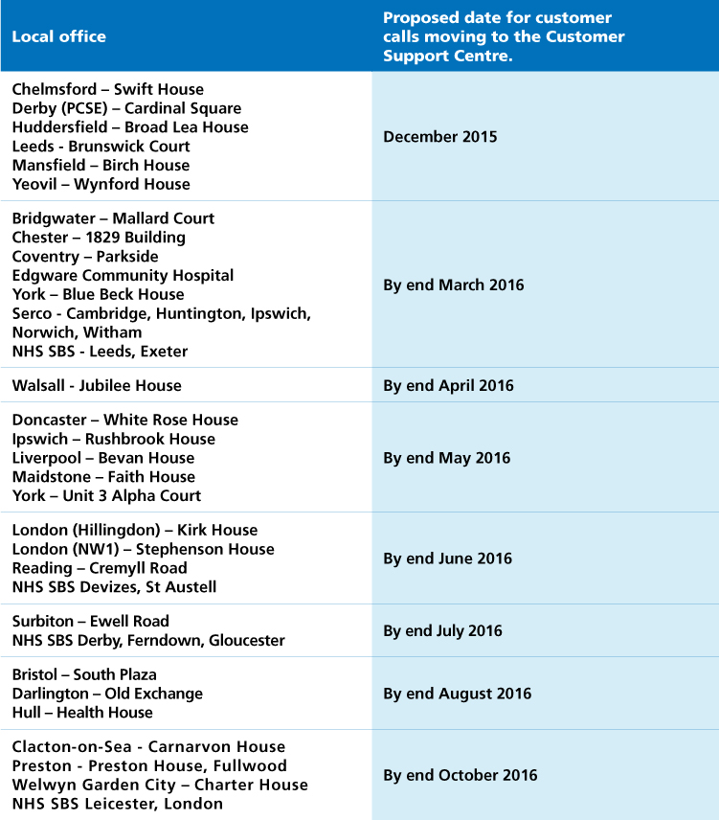
Contacting PCSE: Customer Support Centre

Slide 12
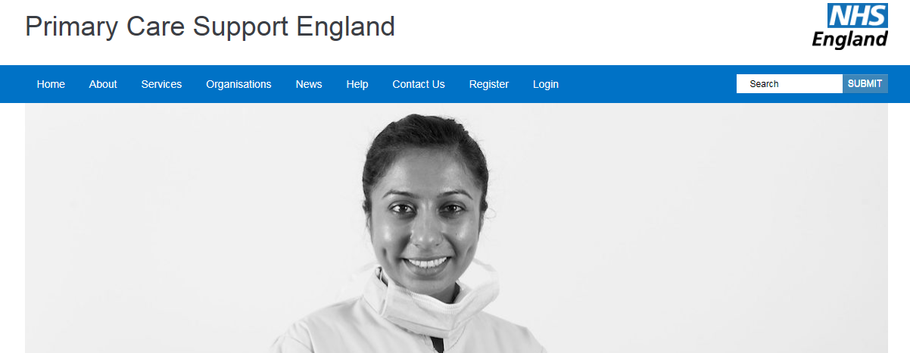
Contacting PCSE: www.pcse.england.nhs.uk
Information on service transformations: when and how they will happen
Detailed FAQs (currently covering Records, Supplies and the PCSE Portal)
Latest news
Access to the PCSE portal

Slide 13

Contacting PCSE: National Engagement Team
Local training managers- providing on the ground support for customers and enabling local service activity to continue
Regional liaison managers – providing ongoing contact with local representative committees

Slide 14
Get involved
BMA Stakeholder Forum Member: Dr Ian Hume
RCGP Forum Members: Dr Janet Hall
Stakeholder user panel:
Contact preference: phone, work email, personal email
Lots of ways to get involved: surveys, polls, phone interviews, workshops and testing early versions of services
Receive regular communications on what we’ve done and what to expect soon
Email us at: PCSEpanel@capita.co.uk

Slide 15


Questions?
Questions?

