Slide 1
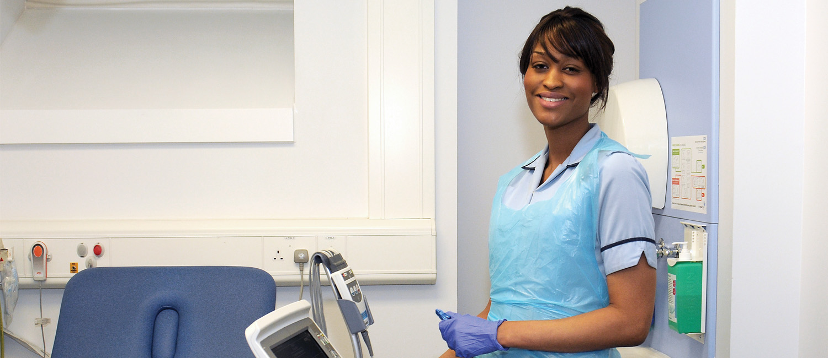

General Practice Workforce Event
Dr Pete Lane

Slide 2
Strategic Drivers
Five Year Forward View – NHSE Oct 2014
The New Deal for General Practice – NHSE Jan 2015
Shape of Caring Review - Raising the Bar - Lord Willis Mar 2015
GPN Education & Career Framework – HEE May 2015
The Future of Primary Care – Roland Report July 2015
General Practice Nursing in the 21st Century
- a Time of Opportunity – QNI Jan 2016
GENERAL PRACTICE FORWARD VIEW April 2016
UNDERSTANDING PRESSURES IN GP May 2016
@NHS_HealthEdEng #ATPS

Slide 3
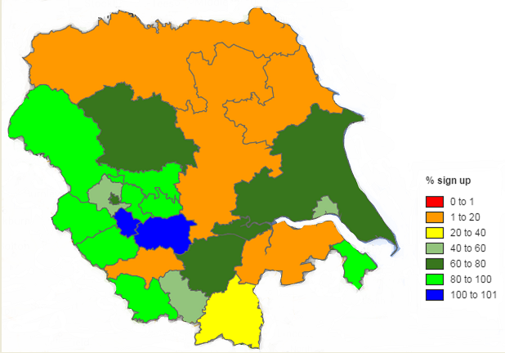
Workforce Toolkit
Over 70% coverage of 800 General Practices across 23 CCG’s

Slide 4
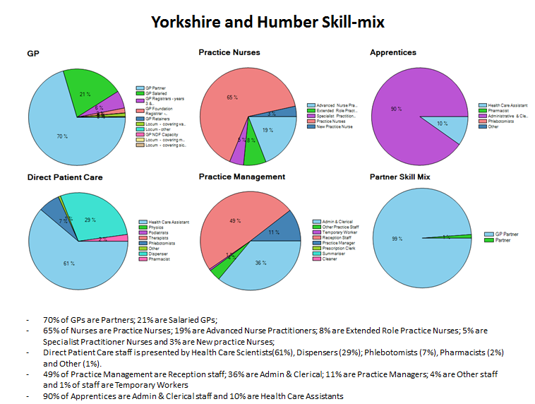

Slide 5
Critical Stats
Ratio of FT equivalents across HEE
GP : GPN/ANP : HCA
4 : 2 : 1
@NHS_HealthEdEng #ATPS

Slide 6
Retirement Risk
Aged over 55
GP 15%
GPN/ANP 26%
HCA 20%
Practice Managers 29%
@NHS_HealthEdEng #ATPS

Slide 7
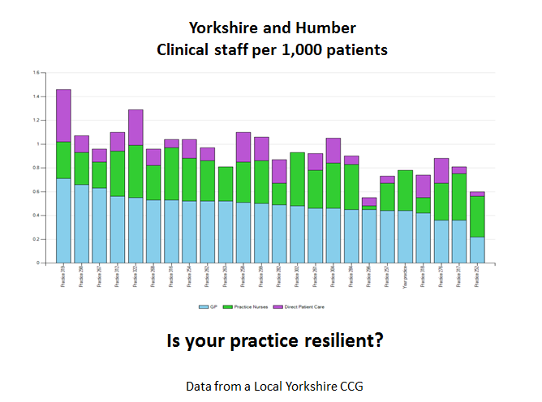
@NHS_HealthEdEng #ATPS

Slide 8
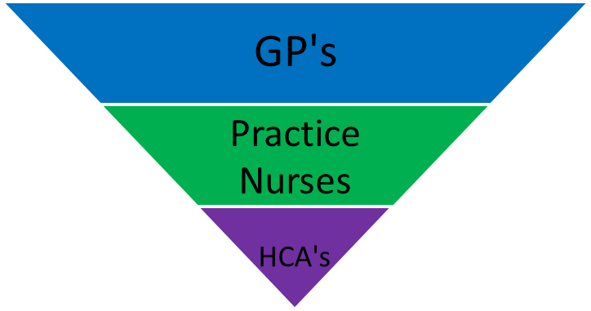
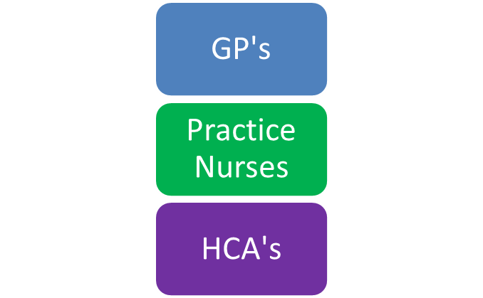
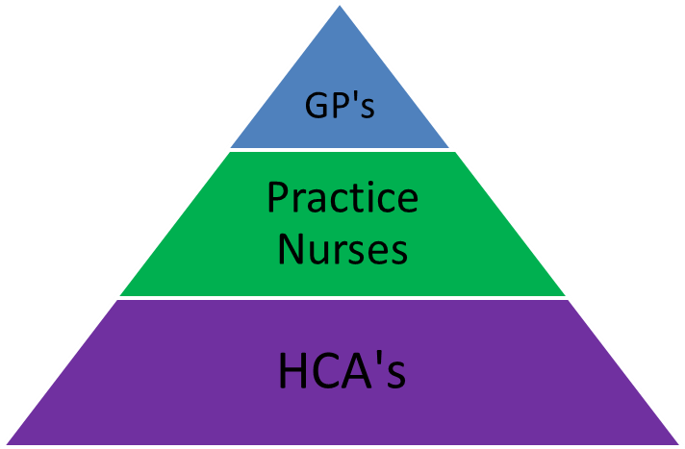
Evolving Workforce Configurations
The Toblerone Manoeuvre
@NHS_HealthEdEng #ATPS

Slide 9
New Kids on the Block
ACPs
Physicians Associates
Pharmacists
Medical Assistants
Nursing Associates
Care Navigators
Physios
O.T’s
Paramedics
Social Workers
Mental Health
@NHS_HealthEdEng #ATPS

Slide 10
Where’s the Cavalry?
Recycling existing workforce
Poaching from each other
There is no GP nurse workforce pipeline
Houston we have a problem!!
@NHS_HealthEdEng #ATPS

Slide 11
Training hubs,Training Hubs, Training Hubs
Point 3 of 10 point plan:
“NHS England will invest in the development of training hubs, where groups of practices can offer interprofessional training to primary care staff, extending the skills base within general practice and developing a workforce that can meet the challenge of new ways of working”

Slide 12
The Advanced Training Practice Scheme
“Grow your own”
From Idea to Industrialisation to Normalisation

Slide 13
The ATP Model
Goal: Every u/g student nurse to have a substantive placement in General Practice
8 hub practices set up providing regional coverage
Each hub recruits a network of spoke practices (similar to VTS model)
Hub patch to be 20+ practices
Admin funding from Health Education England working across Yorkshire and the Humber and tariff payments to practices taking student nurses
All placements minimum of 6 weeks
@NHS_HealthEdEng #ATPS

Slide 14
Where are we now?
163 practices involved to date ( over 20% of all practices in region and growing)
Over 350 nurse placements 2015/2016
Superb student and mentor evaluations
Strong network with quarterly steering groups and bi-annual workshops growing GPN educational and leadership talent
After sales service-the dating agency
@NHS_HealthEdEng #ATPS

Slide 15
Key Achievements
Sustainable model capable of national roll-out with a Regional footprint
Cultural Shift – dispelled the myth that new practice nurses need post qualification secondary care experience-they don’t!
Massive career choice sea change-32% pre-post to 91% after would consider GPN career
Value added holistic care experience for nurses pursuing acute sector careers
Conversion rate – increasing numbers of nurses taking GPN posts straight from qualification.
HSJ Award – National Winner Workforce Category 2014
Identifying and promoting GPN educators and leaders

Slide 16
Developments
HCA apprenticeship incentive scheme - 70+ entrants this year with capacity for additional up to 100 places in 2016/17
Launch of GPN Ready Scheme for new entrants to general practice with 50 places linked to Year 2 mentor training
Introducing additional short student placements (less than 6 weeks) at request of HEI’s-for evaluation
@NHS_HealthEdEng #ATPS

Slide 17
Big Challenges I know I have font issues!
Increasing numbers of nurse mentors and especially sign off mentors
GP Engagement
CCG engagement
Joining up the dots-set up 3 Workforce groups across the region
Workforce Roadshows to promote hub visibility and local engagement in Workforce Matters

Slide 18
New World.
Describing the “Educational Practice”
ATPS Video
@NHS_HealthEdEng #ATPS

Slide 19

UPSKILLING

Slide 20

SUPERVISION

Slide 21
Key Messages
-Have a compelling narrative
-Develop a shared vision across ALL your stakeholders
-Identify local champions
-Be relentless
-Do not try to Do Things to GPs-the change management needs GP
ownership!! -
@NHS_HealthEdEng #ATPS

Slide 22
Thanks
Chat time…........
ATPS Video
@NHS_HealthEdEng #ATPS

